Slide 1


Digital systems
Chapter 5
Compter organization
Dr. Iness NEDJI MILAT (Lecturer)
iness.nedji@ensia.edu.dz
Pr. Nasreddine LAGRAA
First year – 2023/2024
Nasredine,lagraa@ensia.edu.dz

Slide 2
Von Neumann Model

Slide 3
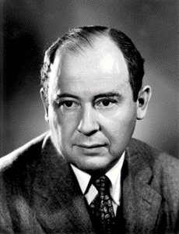
Von Neumann model
John von Neumann proposed a fundamental model in 1945, for processing computer programs.
It is also known as the Von Neumann Architecture.
It describes the design architecture for a computer with these components:
  Central processing unit (CPU)
  Main memory that stores data and instructions (programs),
  Input and output devices,
  All these components are connected via buses.
Notes:
You can change the world only if you understand it well enough…
Especially the past and present dominant paradigms
And, their advantages and shortcomings – tradeoffs
And, what remains fundamental across generations
And, what techniques you can use and develop to solve problems

Slide 4
Von Neumann model : Two Key Properties
Von Neumann model is also called stored program computer. It has two key properties:
  Stored program
    Both Data and Instructions are stored in a same memory,
  Sequential instruction processing
    The CPU executes one instruction at a time using the Fetch-Decode-Execute cycle
    Program counter (instruction pointer) identifies the current instruction
    Program counter is advanced sequentially except for control transfer instructions

Slide 5
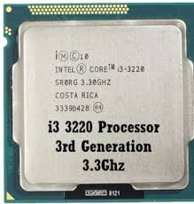
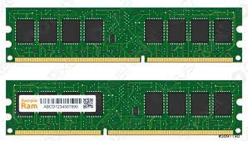
Von Neumann model
Processes data and instructions and controls the computer system
Central processing Unit
Monitor,
Printer,
Disk,…
Manages execution of instructions by sending control signals to other parts of the CPU.
Control Unit
Registers
Registers
Input
Output
Temporary storage locations within the CPU(Fast).
Arithmetic and Logic Unit: carries out arithmetic and logical operations.
ALU
Keyboard,
Mouse,
Disk,…
Buses : Wires that are used to transfer data between components
Main Memory
stores the program (instructions and data)

Slide 6
Buses

Slide 7
Von Neumann model : Buses
Buses are a communication system that transfers information (Instruction, data, address, control signal) between components inside a computer,
Von-Neumann Architecture comprised of three major bus systems for data transfer : Address bus, Control bus and Data bus
Main Memory
Input/Output
CPU
Buses

Slide 8
Types of Buses
Main Memory
Input/Output
CPU
Address Bus
Control Bus
1
0
Data Bus
1
0
1
1
1
Parallel lines
0
A bus structure consists of a set of common lines, one for each bit of a binary information.

Slide 9
Types of Buses
Data Bus
  Carries the data between the CPU, the memory and the Input/Output devices
  Bidirectional : Either the CPU writes data to memory, or it read data from memory
  May consist of 32, 64 or more separate lines
  The number of lines is referred to as the width of the data bus,
  The number of lines determines how many bits can be transferred at a time
  The width of the data bus is a key factor in determining overall system performance
Notes:
A system bus consists, typically, of from about fifty to hundreds of separate lines.
The data lines provide a path for moving data among system modules. These
lines, collectively, are called the data bus. The data bus may consist of 32, 64, 128, or
even more separate lines, the number of lines being referred to as the width of the
data bus. Because each line can carry only 1 bit at a time, the number of lines determines
how many bits can be transferred at a time. The width of the data bus is a key
factor in determining overall system performance. For example, if the data bus is
32 bits wide and each instruction is 64 bits long, then the processor must access the
memory module twice during each instruction cycle.

Slide 10
Types of Buses
Address Bus
  Carries the address of data between the CPU and the memory units,
  Unidirectional : the CPU always sets the bus to indicate the address of memory word being read or written.
  Its width determines the maximum possible memory capacity.
Control Bus
  Carries control signals (commands) from the CPU in order to control and coordinate all the activities within the computer,
  Unidirectional : the CPU always sets it to indicate operations to be performed.
Notes:
The address lines are used to designate the source or destination of the data on
the data bus. For example, if the processor wishes to read a word (8, 16, or 32 bits)
of data from memory, it puts the address of the desired word on the address lines.
Clearly, the width of the address bus determines the maximum possible memory
capacity of the system. Furthermore, the address lines are generally also used to
address I/O ports. Typically, the higher-order bits are used to select a particular
module on the bus, and the lower-order bits select a memory location or I/O port
within the module. For example, on an 8-bit address bus, address 01111111 and
below might reference locations in a memory module (module 0) with 128 words
of memory, and address 10000000 and above refer to devices attached to an I/O
module (module 1).
The control lines are used to control the access to and the use of the data and
address lines. Because the data and address lines are shared by all components,
there must be a means of controlling their use. Control signals transmit both command
and timing information among system modules. Timing signals indicate the
validity of data and address information. Command signals specify operations to be
performed. Typical control lines include:
• Memory write: causes data on the bus to be written into the addressed location
• Memory read: causes data from the addressed location to be placed on the
bus
• I/O write: causes data on the bus to be output to the addressed I/O port
• I/O read: causes data from the addressed I/O port to be placed on the bus
• Transfer ACK: indicates that data have been accepted from or placed on the
bus
• Bus request: indicates that a module needs to gain control of the bus
• Bus grant: indicates that a requesting module has been granted control of the
bus
• Interrupt request: indicates that an interrupt is pending
• Interrupt ACK: acknowledges that the pending interrupt has been recognized
• Clock: is used to synchronize operations
• Reset: initializes all modules

Slide 11
Main Memory

Slide 12
Conceptual view of memory
The memory unit that establishes direct communication with the CPU is called Main Memory. It is often referred to as RAM (Random Access Memory).
A memory unit stores binary information (Instruction or data) in groups of bits called words.
The data consists of m lines :
  Data input lines provide the information to be stored (written) into the memory,
  Data output lines carry the information out (read) from the memory.
The address consists of n lines which specify which word (among the 2^{n} words available) to be selected for reading or writing.
The control line Read/Write (1/0) specifies the direction of transfer of the data (Memory operation).
The control line Chip Select (CS) selects the chip box to be read from/written to.
n
Main Memory
2^{n} words
m bits per word
n address lines
CS
R/W
m
m data lines

Slide 13
Array Organization of Memory
Main Memory
2^{n}- 1
Word 2^{n} -1
•
•
•
Address bus
n lines
•
•
CS
Deepth (2^{n})
R/W
Data bus
•
•
m lines
2
1
Word 1
@
0
B_{m-1}
...
B₃
B₂
B₁
B₀
Word 0
Width (m)
Notes:
An array with N address bits and M data bits:
2^{N} rows and M columns
Depth: number of rows (number of words)
Width: number of columns (size of word)
Array size: depth × width = 2^{N} × M

Slide 14
Array Organization of Memories : Example
Main memory
Address bus : n = 3 lines
  Memory size = 2³ words = 8 words
Data bus : m = 4 lines (word = 4 bits)
  Memory size = 2³ × 4 bits = 32 bits
For example, the 4-bit word stored at address
5 is 1000
7 | 0 | 0 | 1 | 1
6 | 1 | 1 | 1 | 0
5 | 1 | 0 | 0 | 0
4 | 1 | 0 | 1 | 1
3 | 1 | 0 | 1 | 1
2 | 1 | 0 | 0 | 0
1 | 0 | 1 | 1 | 0
0 | 0 | 0 | 0 | 1
Deepth
addresses
Width

Slide 15
Memory array architecture
Main memory
Memory is a 2D array of bits.
Each bit stored in a cell memory.
Address Decoder selects a word line
R/W selector determines access type
CS selector determines a chip box
Word line is then coupled to the data lines
Cell
Word 2^{n} -1
Address bus
Decoder
Word 1
R/W
CS
Word 0
Data bus

Slide 16
Memory: Write and Read Operations
The Write operation:
  Transfers the address of the desired word to the address lines
  Transfers the data bits (the word) to be stored in memory to the data input lines
  Activates the Write control line (set Read/Write to 0)
The Read operation:
  Transfers the address of the desired word to the address lines
  Activates the Read control line (set Read/Write to 1)
  Transfers a copy of the accessed word to the data output lines

Slide 17
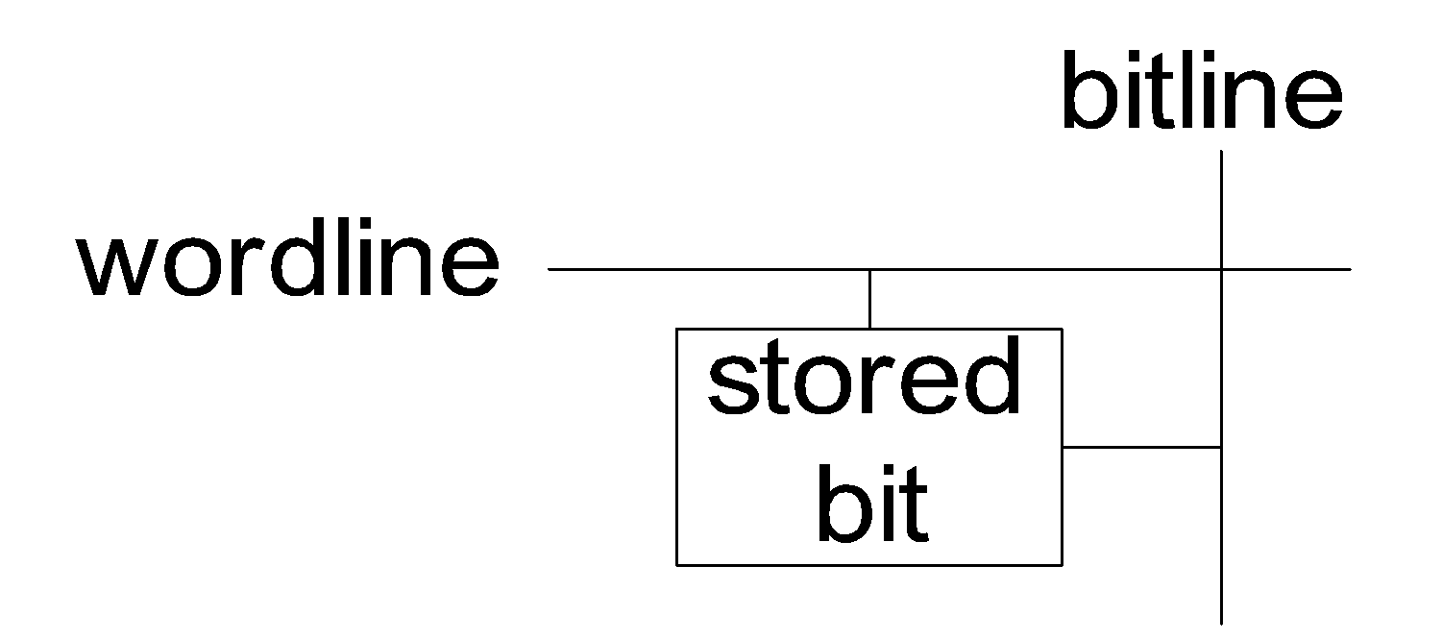
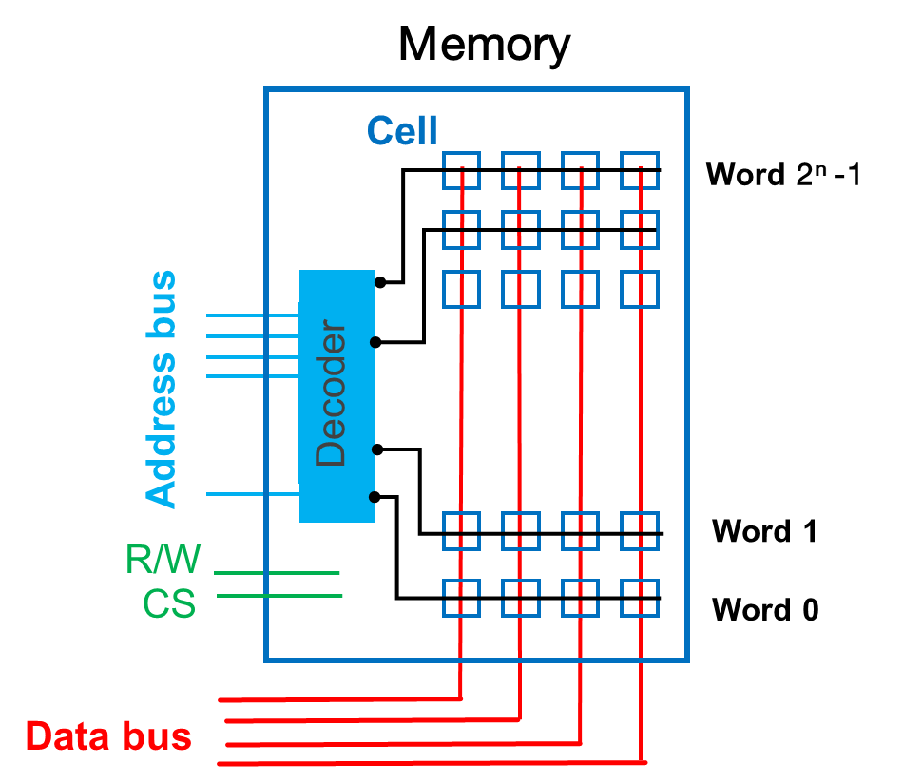
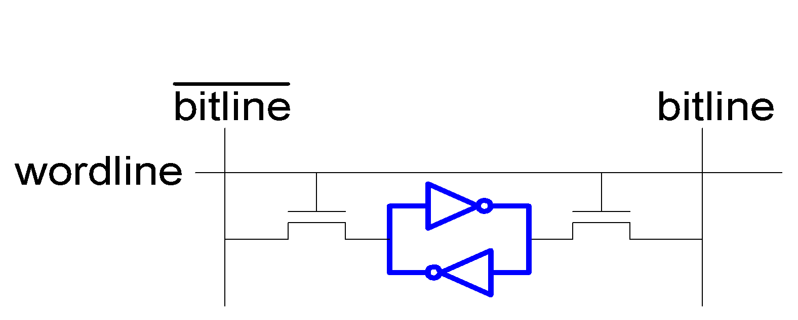
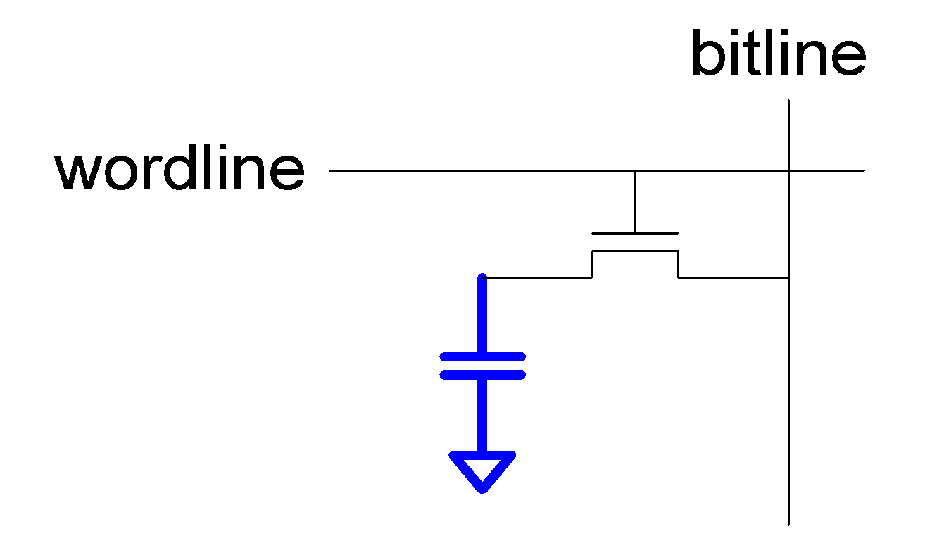
Implementation of Cells
Modern computer memory is implemented as semiconductor memory, where data is stored within memory cells built from MOS transistors and other components
DRAM (Dynamic RAM)
Main memory
SRAM (Static RAM)
Cache memory

Slide 18

Memory Technology : SRAM
Static random access memory
Two cross coupled inverters store a single bit
  Feedback path enables the stored value to persist in the “cell”
  4 transistors for storage
  2 transistors for access

Slide 19

Memory Technology: DRAM
Dynamic random access memory
Capacitor charge state indicates stored value
  Whether the capacitor is charged or discharged indicates storage of 1 or 0
  1 capacitor
  1 access transistor
The electric charge on the capacitors gradually leaks away
  DRAM cell loses charge over time
  DRAM cell needs to be refreshed
Refresh : A DRAM controller must periodically rewrites the data in the capacitors, restoring them to their original charge
The need to refresh DRAM demands more complicated circuitry and timing than SRAM.

Slide 20
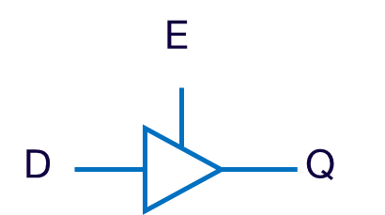
Tri-State Buffers
If enabled (E=1), then Q = D
Otherwise, Q is not connected
DRAM Write operation
Tri-State buffer
Selected word line
= 0
= 1
Data output line
Data input line

Slide 21
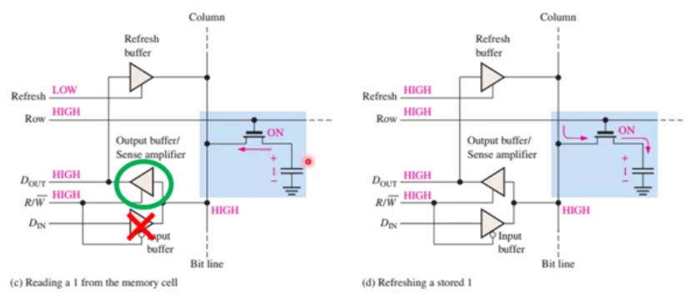
DRAM Read operation
Destructive reads

Slide 22
Central Processing Unit

Slide 23
Central Processing Unit (CPU) : Registers
The CPU is responsible for executing the instructions of a computer programs. Its major components are : Control Unit, ALU and a variety of registers.
Program Counter : holds the memory address of the next instruction to be executed.
Central processing Unit
How they are organized into the CPU?
Registers
PC
Control Unit
PC
Memory Address Register : holds the memory address of either the data or the instruction.
MAR
MAR
Accumulator : holds the results of calculations carried out by the ALU
ACC
ACC
IR
IR
Instruction Register : holds the current instruction to execute
ALU
MDR
MDR
Memory Data Register : holds the data or instruction retrieved from main memory.

Slide 24
Organization of CPU components
Buses
General Purpose Registers (Reg File) : set of temporary registers used for any purpose. Ex. store operands, intermediate results or arguments of functions…
n lines
Central processing Unit
Program Status Word : set of flag bits (carry, overflow, Interrupt, supervisor flags) and Instruction pointer,..
Main memory
Processing unit
n bits
n
R1
@ 2 - 1
MAR
R2
@ de c ode r
Rn
PSW
PC
ACC
n lines
Control logic bloc (FSM)
16-bit
ALU
Instr. Decoder
m bits
IR
@ 0
m bits
MDR
Control unit
m bits
m lines
m lines

Slide 25
CPU : Control unit
The control unit allows:
  to sequence the execution of the programs’ instructions,
  to ensure the fetching and the decoding of the instruction to execute (which is encoded in binary form)
  to organize the execution of the instruction,
  to carry out the preparation of the following instruction.

